Slide 1

6th Grade Math
Unit 7, Lesson 15 Evaluating Exponents Volume 2, pg. 68

Slide 2


Benchmark
MA.6.NSO.3.3
Evaluate positive rational numbers and integers with natural number exponents.
volume 2, pg. 68

Slide 3
Integrated Mathematical Thinking and Reasoning Standards
MA.K12.MTR.4.1 Engage in discussions that reflect on the mathematical thinking of self and others.
MA.K12.MTR.5.1 Use patterns and structure to help understand and connect mathematical concepts.
volume 2, pg. 68

Slide 4

Learning Targets
I can evaluate integers with natural number exponents.
I can evaluate a positive rational number raised to a power.
volume 2, pg. 68

Slide 5

Warm-Up
volume 2, pg. 68

Slide 6
7.15.1 Warm-Up: Consider the YET
Consider the belief that “you can get better at whatever you want to get better at.” Explain whether you agree or disagree.
Consider the quote, “I’ve never heard of someone who took up running and didn’t get faster the more they did it.” That person just may not have been a fast runner … YET.
Complete the statement to describe something you want to get better at.
I ___________________________________________
_______________________________________...YET!
volume 2, pg. 68

Slide 7

Exploration
volume 2, pg. 69

Slide 8

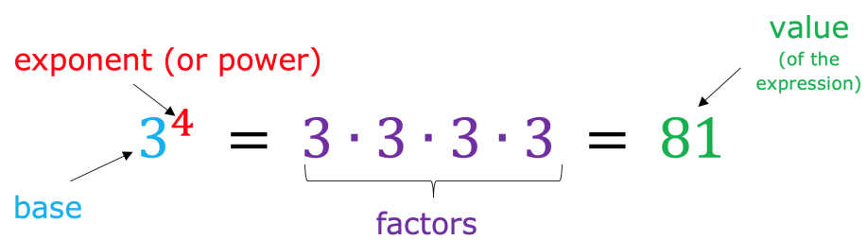
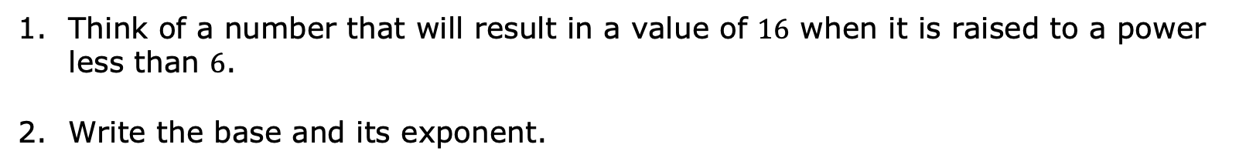
7.15.2 Exploration: Building on the Understanding of Exponents
Recall the vocabulary of exponential expressions.
Think of a number that will result in a value of $16$ when it is raised to a power less than $6$.
Write the base and its exponent.
volume 2, pg. 69

Slide 9
Compare your expression with your partner and check for accuracy.
If your partner found a different base and exponent that meets the description, write it below. If your partner wrote the same base and exponent as you, work together to find a second exponential expression that also works.
volume 2, pg. 69

Slide 10

With your partner, choose one of the exponential expressions used and rewrite it making the base negative.
$$\left(−_____\right)$$
Explain whether the negative base changes the value of the expression.
Discuss with your partner how you could change the exponent to result in a negative answer. Write a brief summary of your discussion below.
volume 2, pg. 69

Slide 11

Bring It Together
volume 2, pg. 70

Slide 12

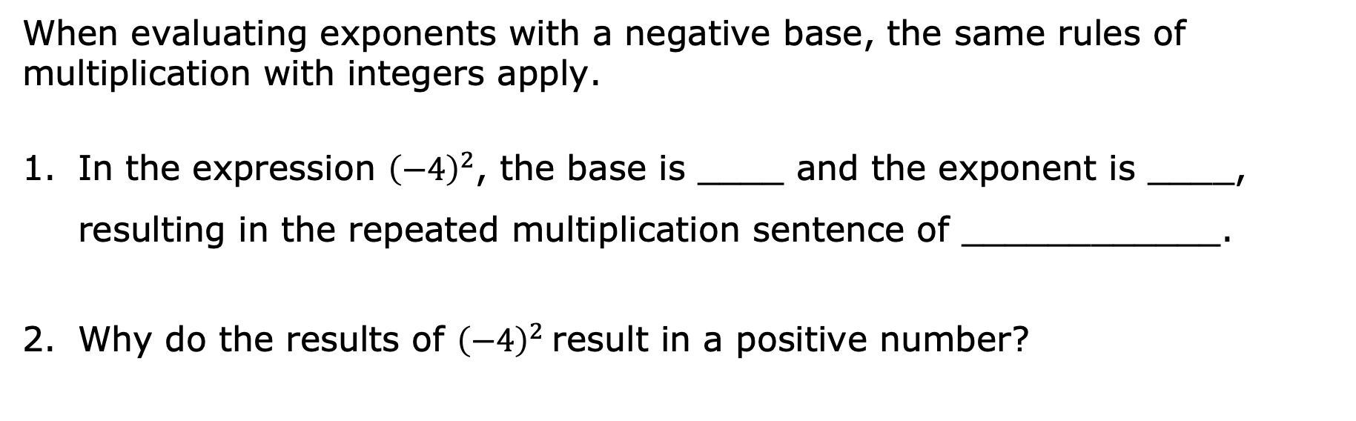
7.15.3 Bring It Together: Building on the Understanding of Exponents
When evaluating exponents with a negative base, the same rules of multiplication with integers apply.
In the expression ${\left(−4\right)}^{2}$, the base is ____ and the exponent is ____, resulting in the repeated multiplication sentence of ____________.
Why do the results of ${\left(−4\right)}^{2}$result in a positive number?
volume 2, pg. 70

Slide 13
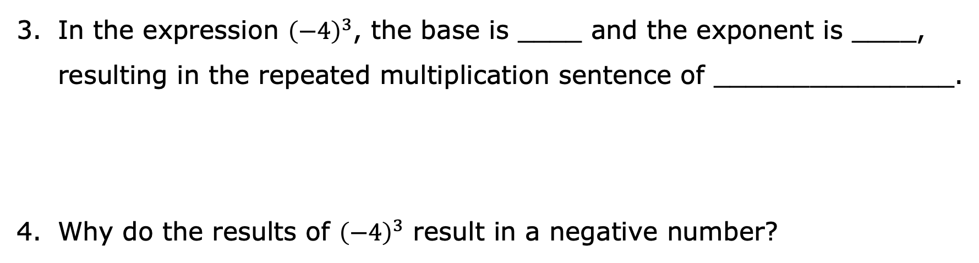
In the expression ${\left(−4\right)}^{3}$, the base is ____ and the exponent is ____, resulting in the repeated multiplication sentence of _______________.
Why do the results of ${\left(−4\right)}^{3}$ result in a negative number?
volume 2, pg. 70

Slide 14
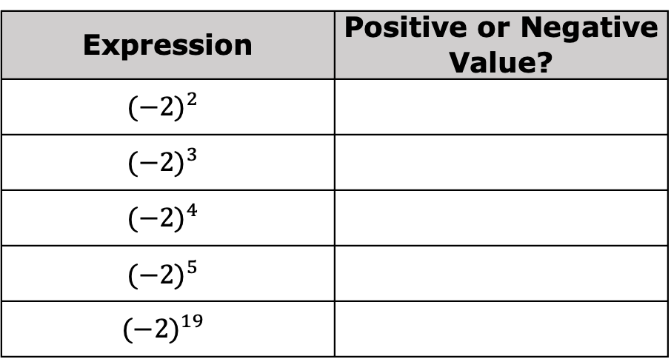
For each expression, determine whether its value is positive or negative.
Expression | Positive or Negative Value?
$${(−2)}^{2}$$
$${(−2)}^{3}$$
$${(−2)}^{4}$$
$${(−2)}^{5}$$
$${(−2)}^{19}$$
volume 2, pg. 70

Slide 15
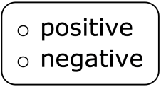
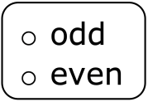
When evaluating exponents with a negative base,
the value of the expression will be if the
exponent is an number, and the value of the
expression will be if the exponent is an
number.
volume 2, pg. 70

Slide 16

Your Turn
volume 2, pg. 71

Slide 17

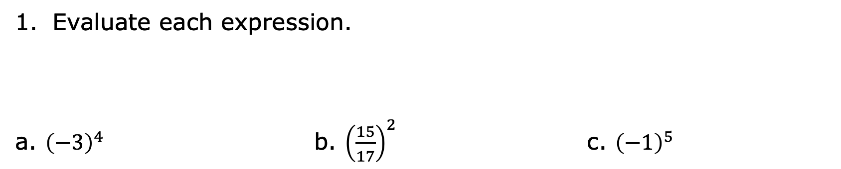
7.15.4 Your Turn!
Evaluate each expression.
a. ${\left(−3\right)}^{4}$ b. ${\left(\frac{15}{17}\right)}^{2}$ c. ${\left(−1\right)}^{5}$
volume 2, pg. 71

Slide 18
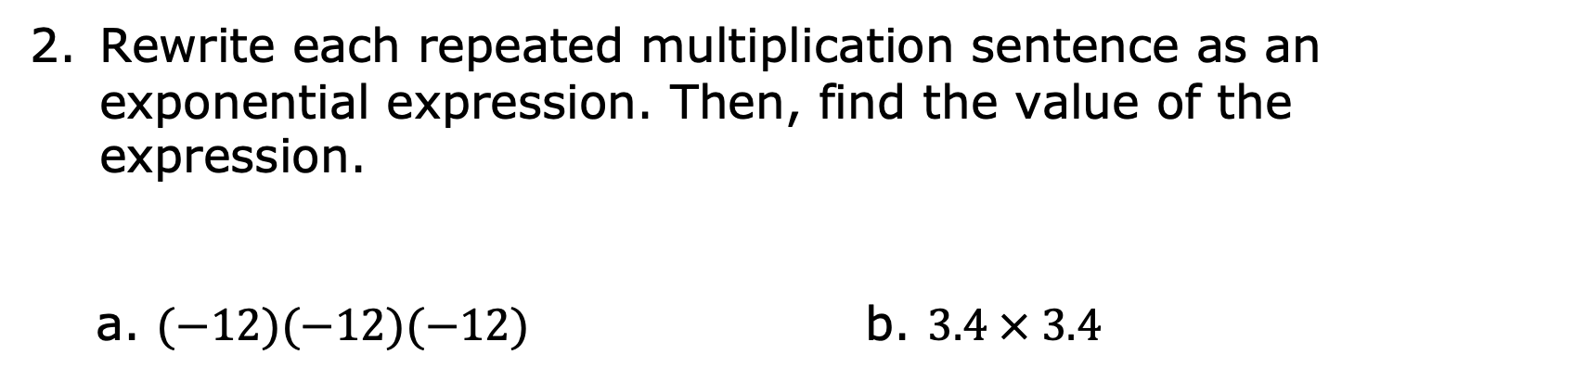
Rewrite each repeated multiplication sentence as an exponential expression. Then, find the value of the expression.
a. $(−12)(−12)(−12)$ b. $3.4 × 3.4$
volume 2, pg. 71

Slide 19
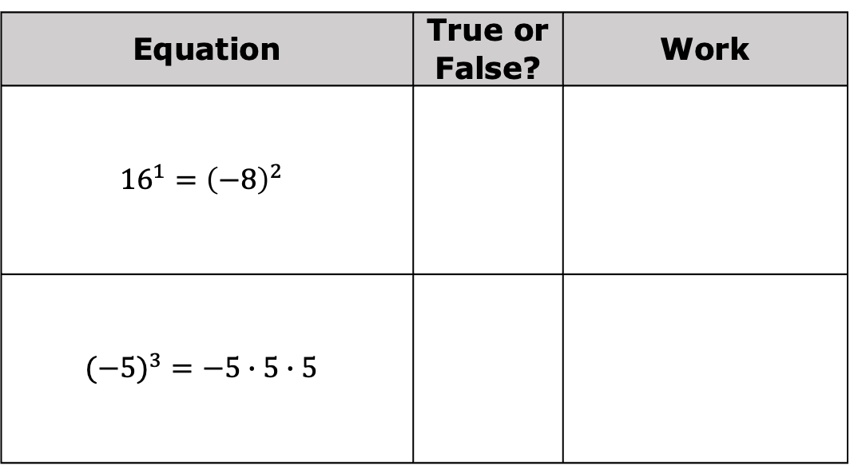
Determine if each equation in the table is true or false. Show your work to support your answer.
Equation | True or False? | Work
$${16}^{1}={\left(−8\right)}^{2}$$
$$(−{5)}^{3}=−5∙5∙5$$
volume 2, pg. 71

Slide 20

Wrap-Up
volume 2, pg. 71

Slide 21
7.15.5 Wrap-Up: Reflection
In this unit, you have learned multiple concepts about operations with integers. Rate yourself on the following skills based on your level of understanding.
Statement | Rating 1 – I struggle with this. 2 – I have some skills. 3 – I am almost there. 4 – I have got this!
I can evaluate positive rational numbers and integers raised to a power.
I can express composite whole numbers as a product of prime factors.
I can add integers.
I can subtract integers.
I can multiply integers.
I can divide integers.
volume 2, pg. 71

